Slide 1
Automated Recommendation System
Niraj Dedhia (njd4185)
Siddharth Bidwalkar (ssb9012)
Sandeep Chaudhary (ssc4763)

Slide 2
INTRODUCTION
Large number of items are available for selection.
Filter required to make best selection out of it. Recommendation system solves this problem.
It navigates through large data collections and predicts user preferences based on user’s navigation history.
Methods:
Content-based Filtering
Collaborative Filtering
Hybrid Technique

Slide 3
ROLE
Analysis – Equal distribution
Development
Content-based Filtering – Niraj Dedhia
Collaborative Filtering – Siddharth Bidwalkar
Hybrid Technique – Sandeep Chaudhary
Testing

Slide 4
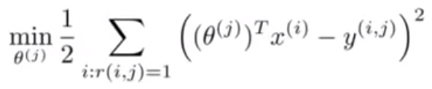
CONTENT-BASED FILTERING
Generate matrix Y where Y( i , j ) = Ratings given by user j for place i.
Calculate the Feature vector for each place based on the average rating for that place.
Compute Parameter vector(θ) for every user with the help of gradient decent.
Now for prediction we applied following formula. Prediction = [Transpose ( Parameter Vector ) ] * [ Feature Vector ]

Slide 5
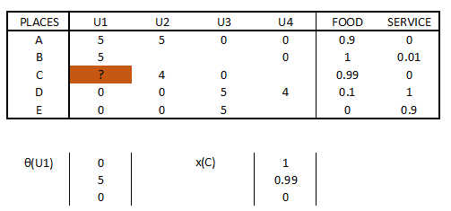
CONTENT-BASED FILTERING

Slide 6
COLLABORATIVE FILTERING
The approach searches for similar restaurants based on restaurants having similar features.
It builds nxn matrix where n is total number of restaurants and each cell contains total number of similar features between 2 restaurants.
For each restaurant, generate list of restaurants where total similar features > 4
For every user request, pass list of restaurants visited by similar users along with list of similar restaurants to hybrid technique algorithm for further processing.

Slide 7
HYBRID TECHNIQUE
Ran the content based filtering to get the user’s parameter vector (i.e. to understand the user’s taste)
Ran the collaborative filtering to classify the datasets of items in to group of similar items and to generate the list of similar users.
Read user ID and filtered out similar users list.
Calculated and merged all the items rated by those similar users and not rated by active user.
Calculated prediction with the help of content based method for all the items with respect to active user’s taste.
Suggested all the items from the above list for which prediction value is high.

Slide 8
TEST CASES
U1008 - Total : 12 matches found out of 138 and List of Places[……]
U1082 - Total : 23 matches found out of 138 and List of Places[……]
U1097 - Total : 17 matches found out of 138 and List of Places[……]
U1020 - Total : 41 matches found out of 138 and List of Places[……]

Slide 9
FUTURE WORK
New users have to dedicate some efforts on to the system to generate a user profile.
This technique is also known as cold start.
The system should show the results based on the latest trending products or highly rated product by different users.

Slide 10
REFERENCES
https://en.wikipedia.org/wiki/Recommender_system
http://recommender-systems.org/content-based-filtering/
http://recommender-systems.org/collaborative-filtering/
https://www.youtube.com/watch?v=saXRzxgFN0o
https://www.youtube.com/watch?v=i6u5ykEHSP8
https://www.youtube.com/watch?v=KkMAgWlYCAQ
http://archive.ics.uci.edu/ml/datasets/Restaurant+%26+consumer+data#

